Slide 1
Secure Web Programming
Lecture 2. Client-side Scripting Language and DOM
Amanda.Lunt@utas.edu.au
Soonja.Yeom@utas.edu.au

Slide 2
Topics
Secure Web Programming
Week13
Review
Basic Web Programming
Web Security
Adv. Web Programming
Fundamentals – protocol, CS model, etc.
HTTP Protocols, Storage
Advanced Web Applications
Human Computer Interaction with Web Page Design
Security Issues and Technologies
Session management
Client-side Scripting Language and Document Object Model
Secure Programming and Users
Common Gateway Interface
Server-side Scripting Language and Privilege configuration
Encryption and Authentication
Advanced Security Issues

Slide 3
Components of a Dynamic Web Programming
last lecture
The semantic structure of the webpage
  HTML 5
The appearance of the webpage
  CSS
The behavior of the webpage
  Client-side Scripting
  Server-side Scripting
    Looked at Dynamic Web page on slide no. 28 (last week)
    Tools (which language do we use?)

Slide 4

What is a script for?
A Script is generally for the actors to perform movie or musical.
browser
Behaviour of the web page

Slide 5
Web Scripting Language
Web Scripting provides the type of instructions for the web browser. It usually run within a browser.
Two major scripting languages:
  Client-side scripting language
  - JavaScript, Action-Script, Dart, VBScript
  Server-side scripting language (will learn next week)
  - ASP, JSP, PHP, Python, Ruby, Server-side JavaScript

Slide 6
Dynamic Web Page with scripts
It is generated by a web application (scripting languages)
  can customize the response on the server to offer personalization
Contents can be changed in response to different contexts or conditions
Client-side scripting
  - Possible condition for the content
    the type of user interaction (i.e. mouse or keyboard action)
Server-side scripting
  - Possible condition for the content
    The time of day
    The type of submitted value (i.e. login or any submission forms)

Slide 7



Client-side vs Server-side
Client-side : script is executed by the web browser
Request for the content of the webpage
Script Executed
File Output
Client computer
Server
Server-side: script is executed by the server before being shown to the client
Request for the content of the webpage
Script Executed
File Output
Client computer
Server

Slide 8
Client-side Scripting
Client-side scripting are executed client-side (by the client’s browser)
Interpreted language
execute each line of script as it comes to it (no need to compile)
Be often embedded within an HTML document
Change the content in response to certain users’ actions
(i.e. click a button)

Slide 9
Client-side Scripting Languages
JavaScript
  The most common client-side scripting language
ActionScript
  A dialect of ECMA Script
  Used for developing the software or website used Adobe flash
Dart
  Open-source web scripting language introduced by Google
VBScript
  Active Scripting language developed by Microsoft
  Modeled on Visual Basic

Slide 10
JavaScript
Developed by Netscape Communications Corporation
Was the first web scripting language to supported by browsers
Should run with HTML
  Create dynamic Web page
  Interpreter is contained within most web browsers
    This causes compatibility problems between different browsers.
JavaScript is a loosely object-based language.
JavaScript is a case sensitive language.

Slide 11
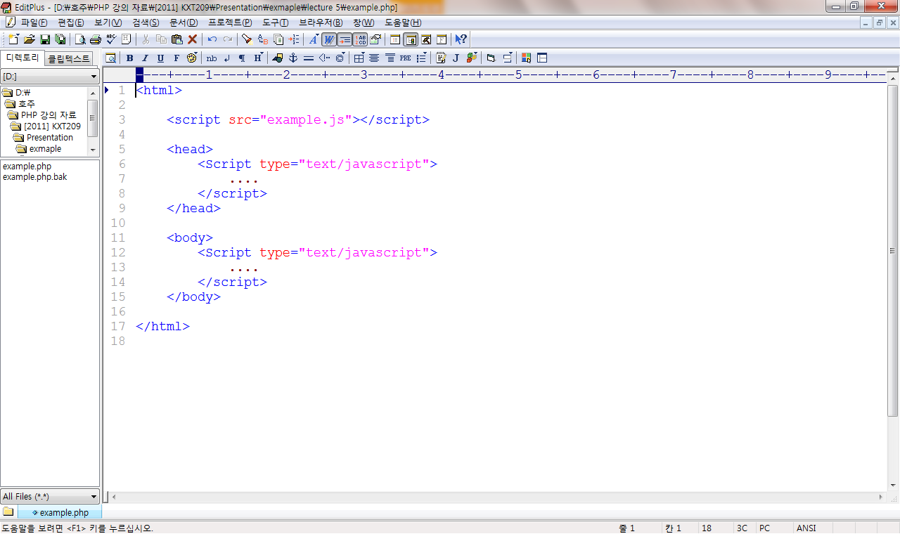
JavaScript in HTML
inside <head>
inside <body>
include external JavaScript source
This enables you to reuse the source code.

Slide 12
General Syntax of JavaScript
Almost same syntax of Java, C, C++, …
  Each statement is terminated by ‘;’
    ‘;’ is an option for the last statement
  Assignment statement by an assignment operator
    var x = 5; // assign the value 5 to x
  Control statement (if, while, for…)
  {…} is a block for multiple statements
    It is normally used with control statement or methods/functions
  Case sensitive
  English name is used as a label for the memory
    Type of value in a variable is dynamic (typeless)

Slide 13
Variable Scope Rules
JavaScript
Global variables
  Variables are declared outside functions
  Available anywhere in the program
  Variables are declared without ‘var’
Local variables
  Variables are declared inside functions
  Only available within the function
  It should be declared with ‘var’
Priority Rules
  If a local variable name is same as the global variable name, the local variable is preferred.

Slide 14
Operator
JavaScript
Numeric Operators
  +, -, *, /, %
Shorthand Operators
  ++, --, -(Unary Negation), +=, -=, *=, /=, %=
Comparison Operator
  <, <=, >, >=, !=, ==, !
Logical Operator
  &&, ||, !

Slide 15
Control Structure
JavaScript
Decision control structures
  If / else / else-if statement
    if(name==valid) { statements }
Repetition control structures
  for / while statement
    for(i=0; i < max; i++) { statements }
    while(i<max) { statements }
Branching statements
  break / continue / return

Slide 16

jQuery
jQuery
One of the most popular JavaScript libraries, released in 2006.
Its syntax is designed for navigating a HTML document (DOM).
Lots of plugins are available.

Slide 17
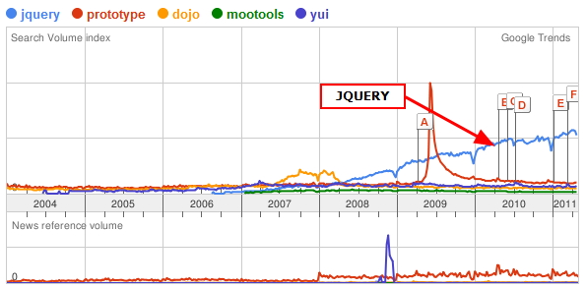
Why jQuery?
jQuery
jQuery…
simplifies JavaScript programming.
resolves cross-browser issue.
method chainable.
jQuery becomes more and more popular and common in the web application development.
JavaScript libraries
https://jquery.com/browser-support/

Slide 18
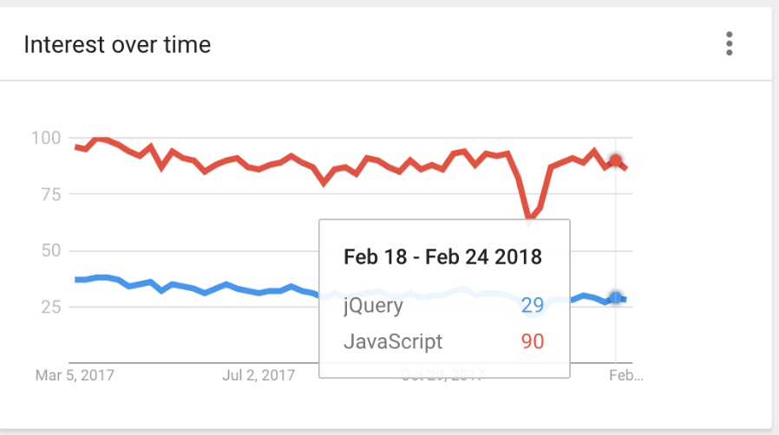
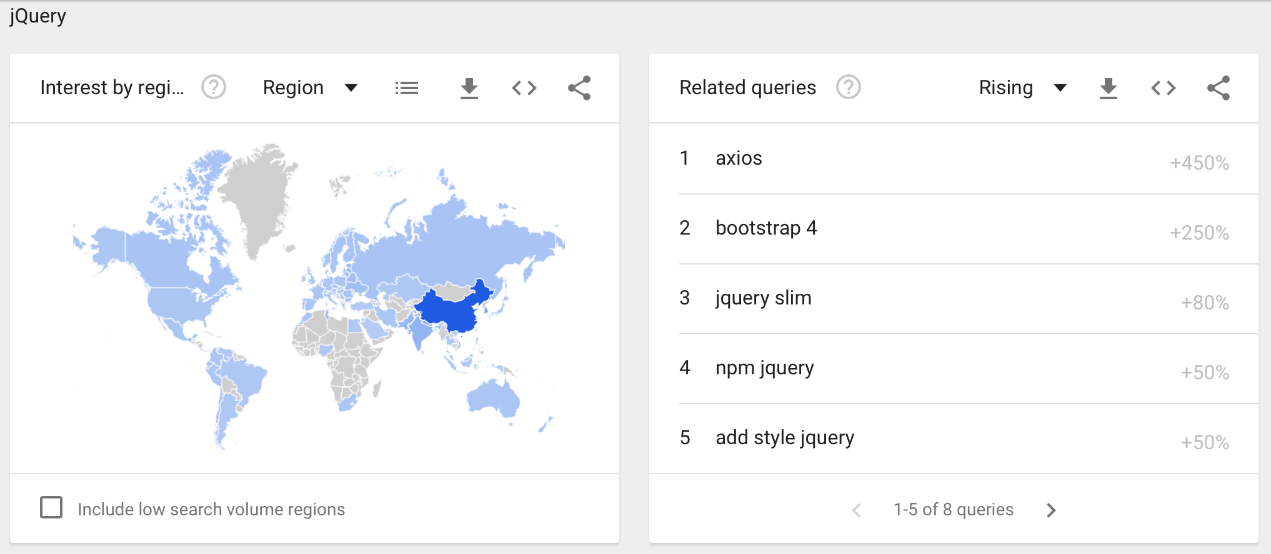
Trends
https://trends.google.com/

Slide 19
jQuery in HTML
Include jquery.js saved in server (download and save)
Include the latest version of jquery.js.
<head>
<script type="text/javascript" src="jquery.js"></script>
</head>
<head>
<script src="http://code.jquery.com/jquery-latest.js"></script>
</head>

Slide 20
jQuery Selector
jQuery Selector is a powerful tool for matching elements in HTML document.
Selector allows to manipulate each element in HTML (HTML tag, ID, Class, etc.).
Every selector starts with dollar sign($)
The ability of selector is the reason why jQuery is the powerful JavaScript library.

Slide 21
jQuery Selector
Syntax | Description
$("*") | selects all elements.
$(“p") | selects all <p> elements.
$("p.intro") | selects all <p> elements with class="intro".
$("p#intro") | selects the first <p> elements with id="intro".
$(":animated") | selects all elements that are currently animated.
$(":button") | selects all <button> elements and <input> elements of type="button".
$(":even") | selects even elements.
$(":odd") | selects odd elements.
How jQuery Selectors manipulate the HTML elements? DOM

Slide 22
What is DOM?
Document Object Model
Document: HTML, XHTML, or XML Documents
Object: The elements in the document
Model: Relationship among elements

Slide 23
Document Object Model (DOM)
Document Object Model
  a standard way for accessing and manipulating HTML documents
  Node Tree
    Node Tree structure
Root Node
<html>
<head>
<title> Sample </title>
</head>
<body>
<table> sample1 </table>
<form> sample2 </form>
<p> sample3 </p>
</body>
</html>
html
head
body
title
table
form
p

Slide 24
DOM: Type of Nodes
Element Node:
  NodeType =1
  i.e. <element> …</element>
Attribute Node:
  NodeType=2
  i.e. <element attribute=“value”>…</element>
Text Node:
  NodeType=3
  i.e. <element> texttext </element>

Slide 25
DOM and JavaScript
JavaScript access and manipulate the HTML DOM objects.
  Document Object
  Form Object
  Frame/IFrame Object
  Event Object
  Area Object
  …
  You can refer to https://www.w3schools.com/js/js_htmldom.asp

Slide 26
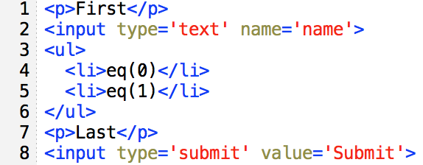
DOM and jQuery
jQuery syntax is designed for making easier to access DOM (Selector $)
  $("p")
  $("ul li:eq(1)")
  $(":input")
  $("p:last")

Slide 27
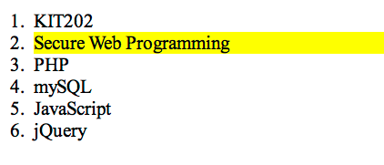
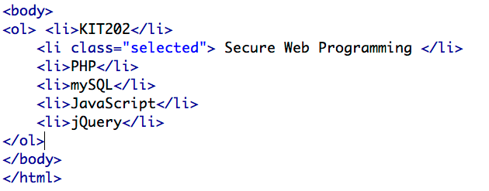
JavaScript vs jQuery :output
Why jQuery?
<output>
<HTML code>

Slide 28
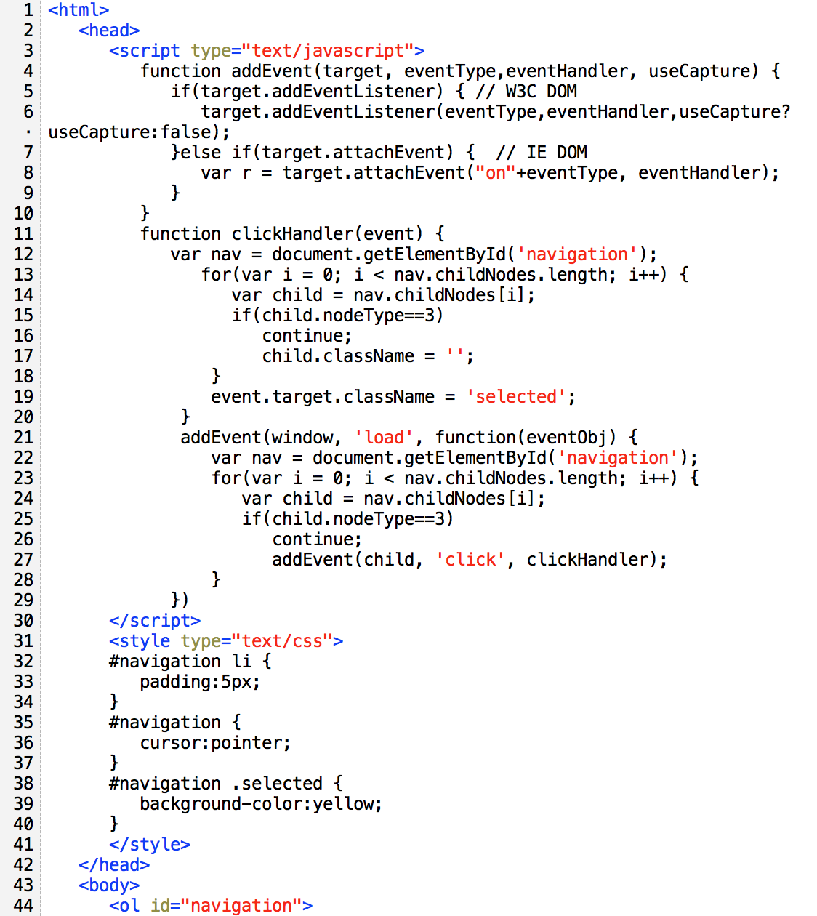
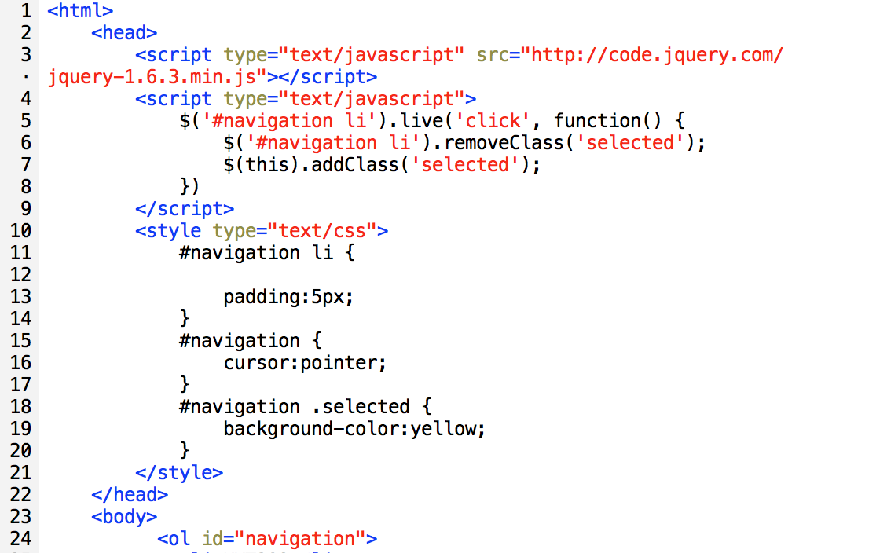
JavaScript vs jQuery :source code
Why jQuery?
JavaScript
jQuery
Same output

Slide 29
Benefits of jQuery: Cross Browser
Some browsers are not W3C DOM compliant.
jQuery provides cross-browser event handling support.
Without jQuery, following function is required to resolve cross-browsing issue.
function addEvent(target, eventType,eventHandler, useCapture) {
if (target.addEventListener){ // W3C DOM
target.addEventListener(eventType,eventHandler,useCapture?useCapture:false);
}else if(target.attachEvent){ // IE DOM
var r = target.attachEvent("on"+eventType, eventHandler);
}
}

Slide 30
Benefits of jQuery: Basic Programming
$(target element).method1().method2();
It’s like a human language.
Hello World!
Subject Predicate
<html>
<body>
<div class="welcome"></div>
<script src="http://code.jquery.com/jquery-latest.js"></script>
<script type="text/javascript">
$('.welcome').html('Hello World!').css('background-color','yellow');
</script>
</body>
</html>

Slide 31
Benefits of jQuery: Method Chainability
The additional function can be called on the previous function over and over again to chain.
$(target element).method1().method2().method3.method4. ….;
  Improve readability
  Ease coding
But, chains that are too long? reduced readability

Slide 32
Method Chainability
  JavaScript without jQuery
  JavaCript with jQuery
<html>
<body>
<a id="tutorial" href="http://jquery.com" target="_self">jQuery</a>
<script type="text/javascript">
var tutorial = document.getElementById (‘tutorial');
tutorial.setAttribute('href', 'http://jquery.org');
tutorial.setAttribute('target', '_blank‘);
tutorial.style.color = 'red';
</script>
</body>
</html>
Same output
<html>
<body>
<a id="tutorial" href="http://jquery.com" target="_self">jQuery</a>
<script src="http://code.jquery.com/jquery-latest.js"></script>
<script type="text/javascript">
$('#tutorial').attr('href', 'http://jquery.org').attr('target', '_blank').css('color', 'red');
</script>
</body>
</html>
Get attribute Change the value to…
*attr(attr,value) sets the value of an attribute for the first element in the set of matched elements.

Slide 33
Advantage of client-side scripting
Allow for more interactivity by immediately responding to users' actions
Execute quickly because they don't require a trip to the server
May improve the usability of Web sites for users whose browsers support scripts
Can give developers more control over the look and behaviour of their Web widgets (note that this can be an advantage or disadvantage)
Can be substituted with alternatives (for example, HTML) if users' browsers do not support scripts

Slide 34
Disadvantage of client-side scripting
Not all browsers support scripts, therefore, users might experience errors if no alternatives have been provided
Different browsers and browser versions support scripts differently, thus more quality assurance testing is required
More development time and effort might be required (if the scripts are not already available through other resources)
Developers have more control over the look and behaviour of their Web widgets; however, usability problems can arise if a Web widget looks like a standard control but behaves differently or vice-versa

Slide 35
Activity using Client-side scripting
Display messages to the user as part of a web page, in the browser's status line, or in alert boxes.
Validate the contents of a form and make calculations (for example, an order form can automatically display a running total as you enter item quantities).
Animate images or create images that change when you move the mouse over them.
Create ad banners that interact with the user, rather than simply displaying a graphic.
Detect the browser in use or its features and perform advanced functions only on browsers that support them.
Detect installed plug-ins and notify the user if a plug-in is required.
Modify all or part of a web page without requiring the user to reload it.
Display or interact with data retrieved from a remote server.

